Slide 1
Global Marketing
Management
A European Perspective
Information Technology Environment
Warren J. Keegan
Bodo B. Schlegelmilch

Slide 2
Overview
IT-Environment: Important Facets
The Age of Technological Discontinuities
New Challenges in Marketing
Evolution in Business Context and Strategies
Summary

Slide 3
Learning Objectives
Understand the main drivers of the information and communication technology (ICT)
Appreciate the role of the internet in providing a platform for e-commerce
Learn how the new technological environment impacts on global marketing activities
Know the components of the electronic value chain

Slide 4
IT-Environment: Important Facets
E-Commerce
Extranet
Internet
Portals
Web Browser
World Wide Web
Virtual Reality
EDI (electronic data exchange)

Slide 5
The Age of
Technological Discontinuities
The speed of technological change has accelerated dramatically
Our environment is characterised by
  technological convergence and
  technological ubiquity
The internet is the most important driver of technological change

Slide 6
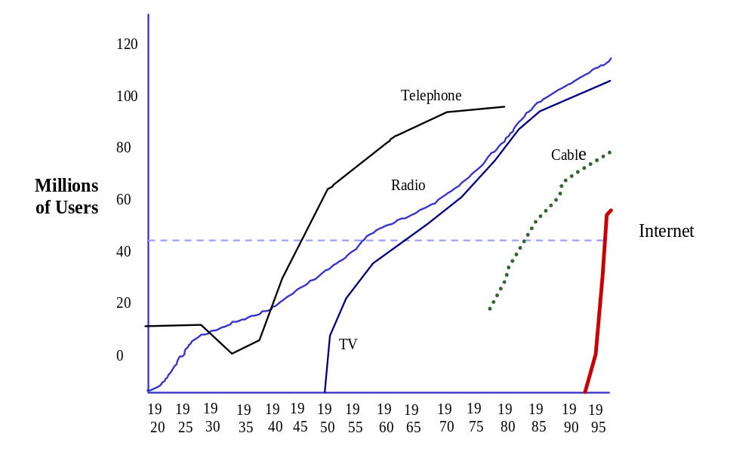
Uptake of Consumer Technologies
Source:
Morgan Stanley, The Internet Advertising Report

Slide 7
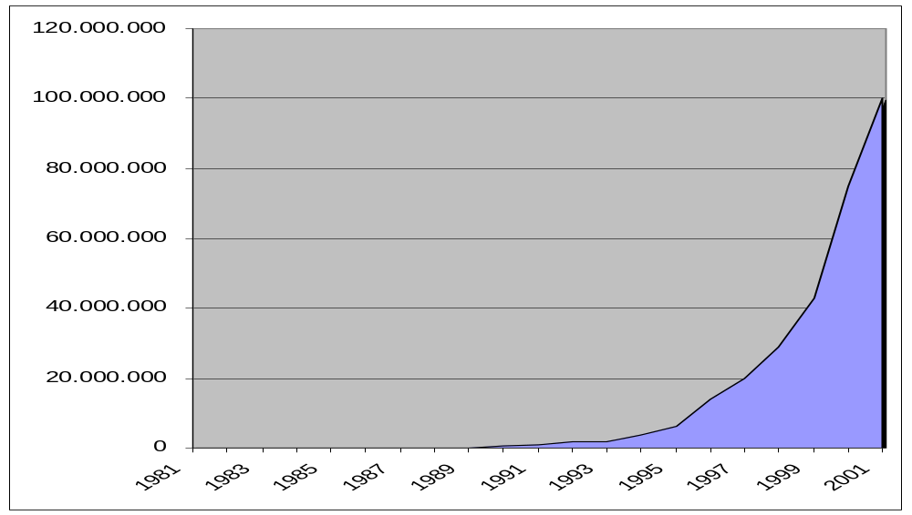
Development of Internet Hosts
Source:
Adopted from: http://www.mids.org/mapsale/data/trends/trends-199907/sld004.htm, 30. Aug. 1999

Slide 8
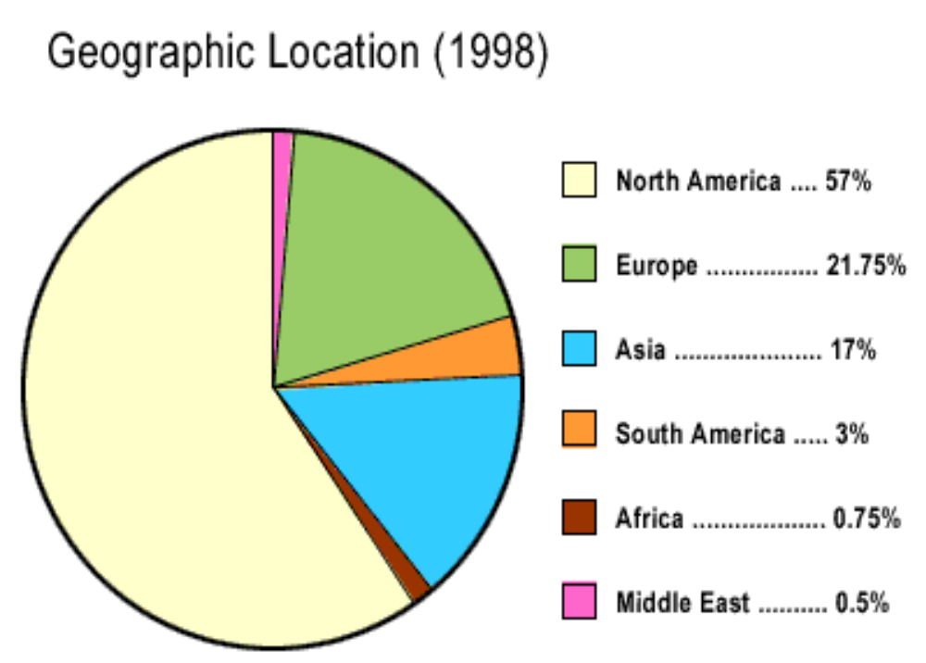
Geographical Distribution of
Internet Users
Source: http://www.nua.ie/surveys/graphs_charts/1998graphs/location.html, 30. August 1999

Slide 9
New Challenges in Marketing
Electronic markets
Virtual organisations
Symbiotic relationships
New forms of cooperation
  Corporate boundaries are blurring
  Organisational hierarchies become flatter

Slide 10
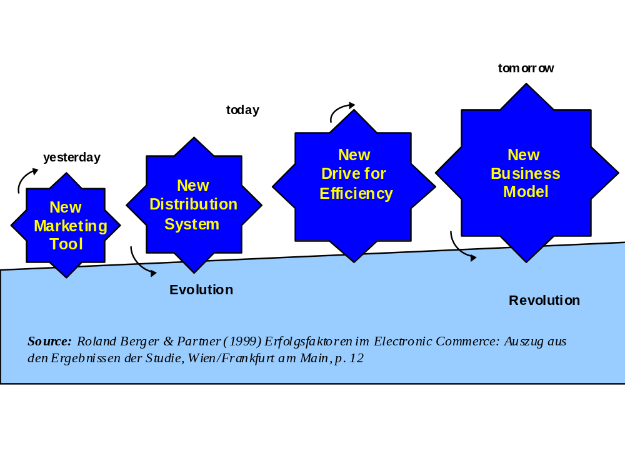
The Evolution of E-Commerce

Slide 11
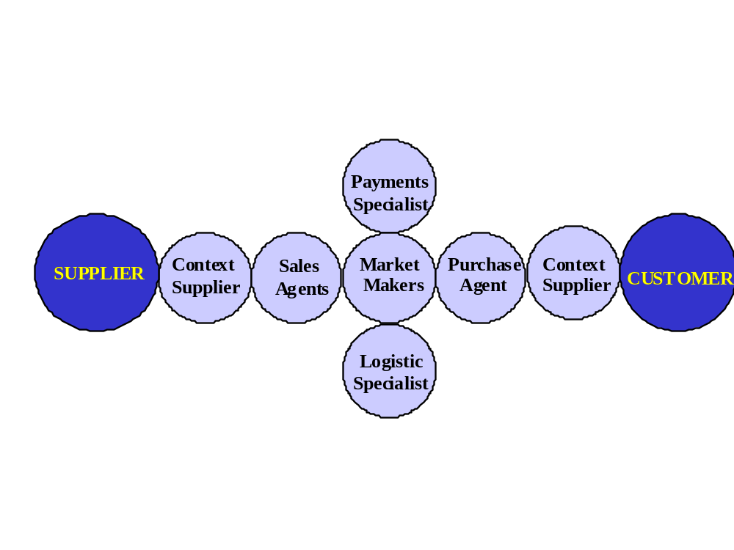
Middlemen as Networks of Specialists
Source:
Adapted from Paul F. Nunes and Brian S. Pappas, ”Der Vermittler auf der Suche nach Reichtum und Glück,” Outlook, Andersen Consulting, Heft 1, 1998, p. 55

Slide 12
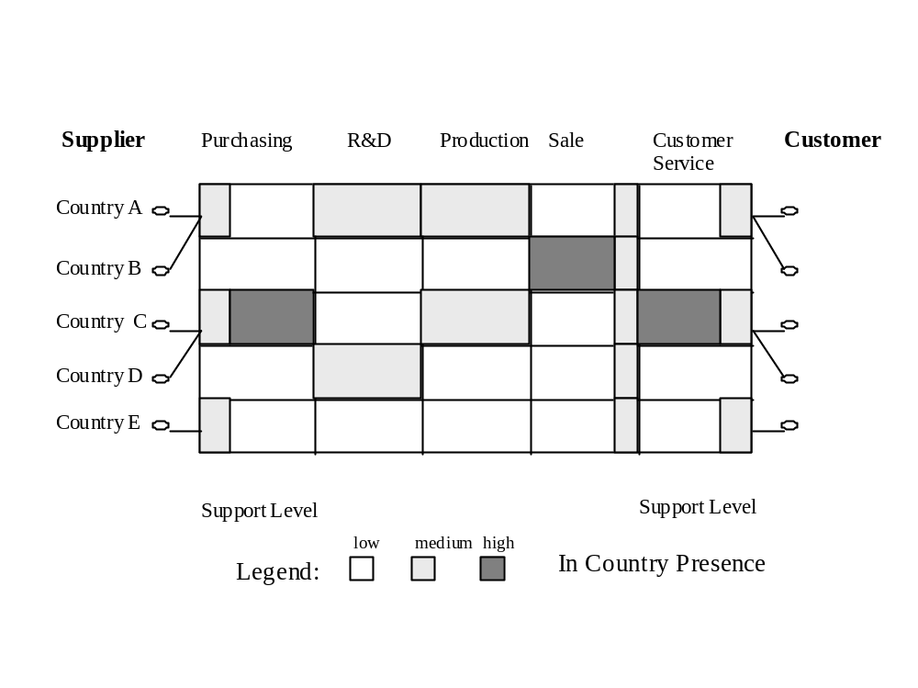
Location of Value Chain
Across Countries
Source:
Adapted from J. Griese, Auswirkungen globaler Informations- und Kommunikationssysteme auf die Organisation weltweit tätiger Unternehmen, in W.H. v. Staehle and P. Conrad (eds) Managementforschung 2, (Berlin / New York), de Gruyter, 1992, p. 423

Slide 13
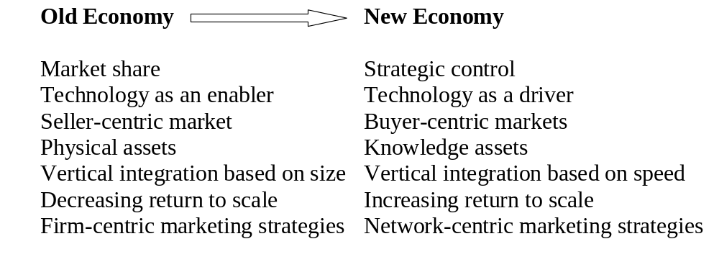
Evolution in Business
Context and Strategies

Slide 14
New Economy Forces Companies to ...
1. secure a dominant market position as quickly as possible
2. form alliances based on their potential for market access and synergies
3. anticipate very high start-up investments
4. defend positions through an ongoing process of innovations.

Slide 15
1. Importance of
Dominant Market Positions
Cases where returns achieved through increased market share grow until market saturation has been reached i.e.
in markets
  with high fixed costs
  with high degree of intellectual factor input
  when the product becomes more valuable when used by more people („network effect“)

Slide 16
2. Importance of Strategic Alliances
Strategic alliances = cooperation of legally independent firms
ICT leads to a reduction of transaction costs
3 types of alliances
  vertical (eg manufacturer & retailer - marketing of an innovative product)
  horizontal (in the same industry, eg r&d)
  diagonal (different industries, eg r&d)

Slide 17
3. Importance of Anticipating
High Start-up Investments
In many e-based industries high start-up costs are necessary to achieve the desired market share
Money is needed
  either from well established financially strong partners
  or from the stock exchange („internet stocks“)
Payback might only be achieved on a long-term basis (in comparison with traditional companies)

Slide 18
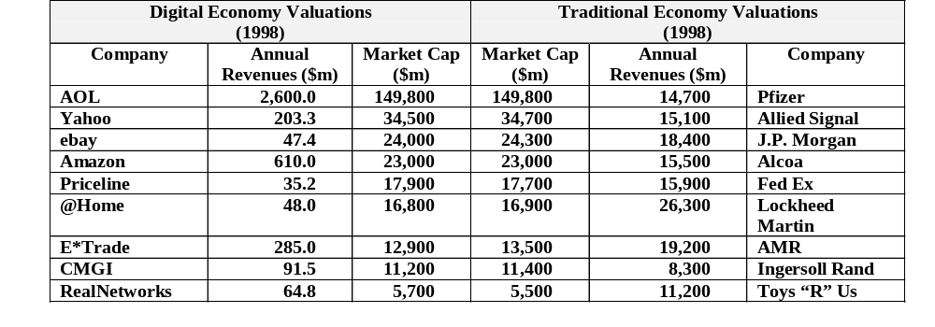
Market Valuations:
New Versus Old Economy
Sources:
Fortune, April 26 and May 24, 1999; Hoover.com; Arvind Rangaswamy, ”Toward a Model of eBusiness Performance,” Presentation at the American Marketing Association Summer Educators’ Conference, San Francisco, August 7-10, 1999.

Slide 19
4. Importance of
Ongoing Innovations
Diffusion speed of new products has increased significantly
Innovation is necessary to keep a compny´s market share
ICT leads to greater efficiencies in all stages of the new product development process

Slide 20
Summary
The rapid advances in ICT are profoundly affecting the way global marketing is conducted („New Economy“).
  additional distribution and communication channels (e-commerce)
  precise targeting (segment of one), customisation and interaction
  fundamentally new business models (network organisations)
  empowered customers

